Slide 1
The Algorithmic Composition of Classical Music through Data Mining
An All-College Thesis
by
Tom Donald Richmond

Slide 2
Introduction
Branch of science [1]

Slide 3
Overview
History
Data
Classification
Generation
Discussion

Slide 4
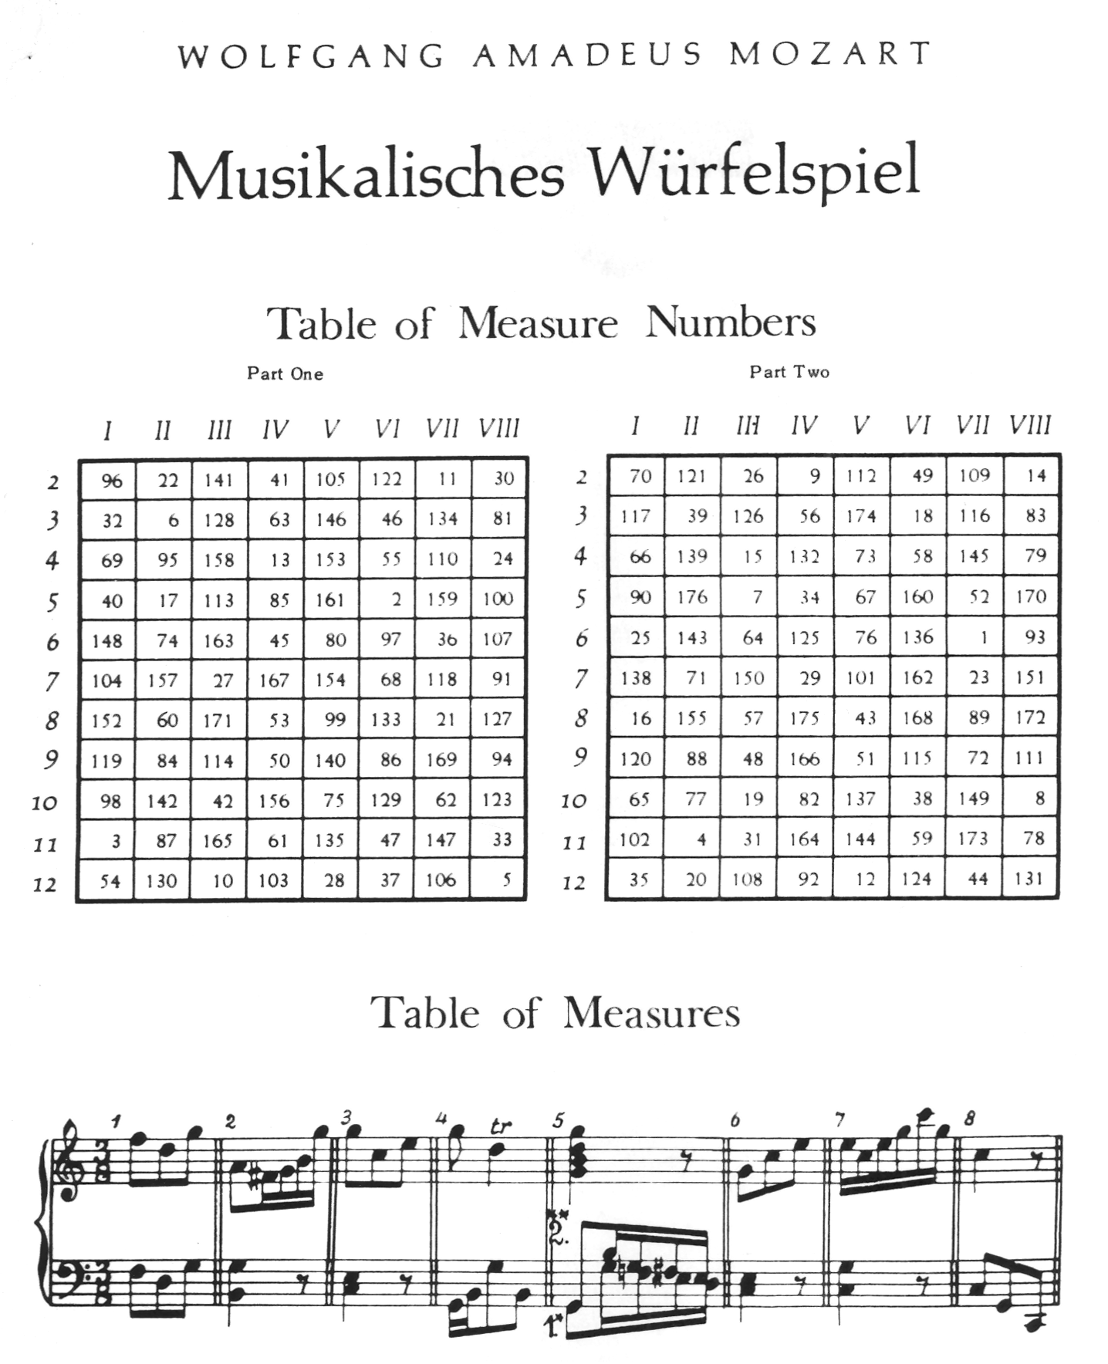
Early Explorations
Music as a discipline of mathematics
Pythagoras and the Musical Spheres [2] - ~500 BC
Mathematics as four disciplines [4] - 6th Century
Music Theory [5] - 6th Century
Computer-less Algorithmic Music
Musikalisches Würfelspiel [6] - 18th Century
Notes:
First significant connections drawn between mathematics and music
Music an official discipline of mathematics (arithmetic, music, geometry and astronomy)
Formal rules by which pitch relations are governed. Music Theory began in Medieval period,

Slide 5
Data Driven Intelligence Era
Illiac Suite [7] – 1958
Markov Chains, stochastic system
Expanded upon by interested parties
Generation
Splinted thereafter
Classification
Variety of styles and classes [8], [9]
Notes:
Moved into the computer age with Hiller and Isaacson’s Illiac Suite
Markovian chains, a stochastic predictive system with a memory of one
Interested parties adapted their work to include an nth order technique
Thereafter, was splintered into many distinct categories of generation (Gerhard Nierhaus: generative grammars, transition networks, genetic algorithms, cellular automata, artificial neural networks (ANNs) and artificial intelligence [3])

Slide 6
Hypothesis
Hybridize these concepts
Utilize the power of predictive classification methodologies to fuel rule based algorithmic composition techniques
Our proposed approach:
Build a classifier that provides friendly output to be utilized in cellular automata-inspired generative process
Notes:
Utilize the power of predictive classification methodologies to fuel rule based algorithmic composition techniques

Slide 7
Musical Representations
Musical score, or sheet music
Visual representation of score, symbols and key words
9th century monks popularized the practice [10]

Slide 8
Digital Formats
Necessity for a new data form
Two predominate datatypes in research
MIDI and **kern

Slide 9
**kern vs MIDI
A “general-purpose software system intended to assist musical research” [12]
Part of Humdrum Syntax
Utilizes Humdrum toolkit
Hand-Encoded
Shallow pool of sources

Slide 10
Data Mining
“The process of discovering useful information in large data repositories” [13]
Splintering within field
Classification, association, clustering
Classification
Definition

Slide 11
Data Extraction
Classification separates data into several predefined classes based upon explicit attributes
Must determine how to separate data, as well as attributes to base it upon

Slide 12
Classes and attributes
Eras of classical music
6 generally agreed upon by experts [5]
Chosen for variety of factors
Aural skills

Slide 13
Attributes
Attributes – or features – are analyzed in an attempt to generate rules for separating the data into the pre-defined classes it has been given
Large number of features to draw upon
Looking for attributes that benefit both generative process and classification process
Musical intervals decided upon (Figure X)
 | Attribute | Description
X₁ | freqUni | Ratio at which unison intervals occur (unison/total)
X₂ | freqStep | Ratio at which stepwise intervals occur (step/total)
X₃ | freqThird | Ratio at which third intervals occur (third/total)
X₄ | freqFourth | Ratio at which fourth intervals occur (fourth/total)
X₅ | freqFifth | Ratio at which fifth intervals occur (fifth/total)
X₆ | freqSixth | Ratio at which sixth intervals occur (sixth/total)
X₇ | freqSeventh | Ratio at which seventh intervals occur (seventh/total)
X₈ | freqOct | Ratio at which octave intervals occur (octave/total)

Slide 14
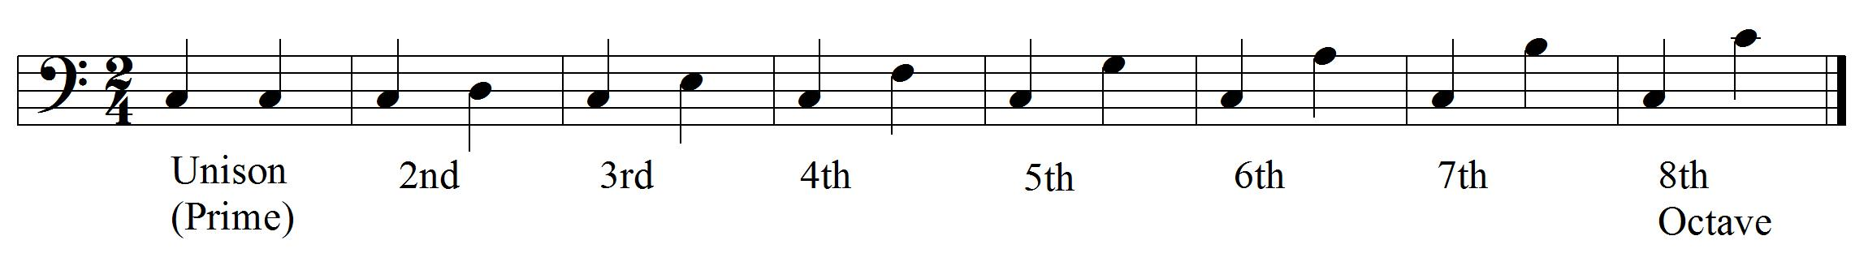
Musical Intervals
Steeped in mathematics, best defined by ratios
A musical interval is distance between any two successive pitches within the piece
Identifying feature in aural skills [16]
Excellent building block

Slide 15
MORE ON INTERVALS
MOAR

Slide 16
Pre-Processing
262 **kern scores (Figure X)
Musical intervals extracted via command line
Humdrum toolkit and egrep (Figure Y)
Each ratio appended to Attribute-Related File Format file, along with class
Class | Number of Data Entries
Medieval | 10
Renaissance | 26
Baroque | 77
Classical | 50
Romantic | 70
Modern | 29
Total | 262

Slide 17
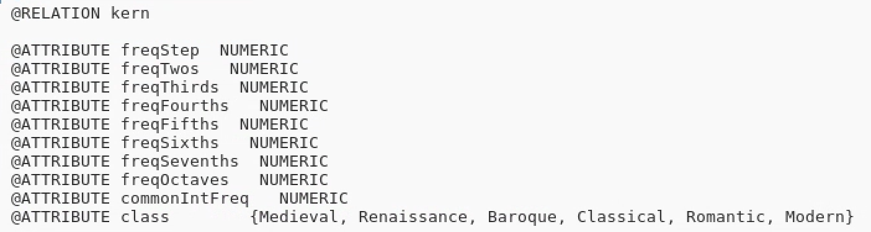
Classes and features

Slide 18
Classifiers
Naïve Bayes
Multilayered Perceptron (ANN)
Logistic Regression
Decision Tree (J48)
Rule Based (JRip)

Slide 19
Results
Ten-Fold Cross Validation
Success based on AUC (area under the curve) of a Receiver Operating Characteristic graph
Naïve Bayes selected based on statistical output and excellent AUC values
 | Medieval | Renaissance | Baroque | Classical | Romantic | Modern | Average
MLP | 0.964 | 0.958 | 0.854 | 0.988 | 0.836 | 0.996 | 0.933
LR | 0.981 | 0.951 | 0.808 | 0.921 | 0.885 | 0.927 | 0.885
Naïve | 0.938 | 0.931 | 0.73 | 0.889 | 0.853 | 0.871 | 0.838
JRip | 0.705 | 0.841 | 0.73 | 0.874 | 0.704 | 0.836 | 0.773
J48 | 0.798 | 0.777 | 0.681 | 0.804 | 0.741 | 0.753 | 0.753

Slide 20
Generation
Challenge:
Based upon output of Naïve Bayes, build a generation technique
Many techniques to choose from (outlined earlier)
Proceeding with cellular automata

Slide 21
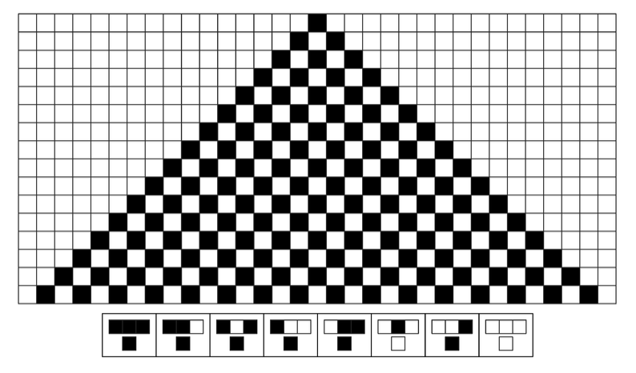
Cellular Automata
John von Neumann 1950’s
Game of Life 1960’s
Grid of cells, each containing one of a finite number of states
Cell state shifts based transitionary rules
Rules derived from neighboring cells
Wolfram Algorithm (Figure X) [18]

Slide 22
Adapted Musical Model
Cellular automata inspired system with four-cell wide grid
Each cell has one of two states: ‘ON’ or ‘OFF’
Binary interpretation of cell sequence mapped to note values (Figure X)
Rules determine the most likely interval from the previous four-cell sequence to the next based upon Naïve Bayes output

Slide 23
Adapted Musical Model

Slide 24
Results
Automated Composition Software
Able to imitate one of six musical eras
New note produced linearly on a timer (currently 750 ms)
Outputs note with a Java MIDI import

Slide 25
Analysis
Indirect
Composed 60 scores of 100 notes, 10 from each respective era
Used as test set to previous training set with previous classifiers
Results performed admirably next to results of original classification process
Direct
Composed three 10-second clips from each era
Presented to six scholars of music with a variety of experiential backgrounds
 | Medieval | Renaissance | Baroque | Classical | Romantic | Modern | Average
MLP | 0.942 | 0.9 | 0.858 | 0.918 | 0.754 | 0.986 | 0.893
LR | 0.978 | 0.938 | 0.824 | 0.946 | 0.836 | 0.998 | 0.92
JRip | 0.852 | 0.753 | 0.662 | 0.816 | 0.582 | 0.786 | 0.742
J48 | 0.812 | 0.757 | 0.757 | 0.8 | 0.678 | 0.826 | 0.772

Slide 26
Discussion

Slide 27
References
[1] P.P. Wiener, Dictionary of the History of Ideas. Studies of Selected Pivotal Ideas. III, Chales Scribner's, 1973.
[2] A. Boethius, “Fundamentals of Music,” in Strunk’s Source Readings in Music History, ed. O. Strun, 1998.
[3] G. Niederhaus, Algorithmic Composition: Paradigms of Automated Music Generation. Vienna, Austria: Springer-Verlag, 2009.
[4] G. Diaz-Jerez, Algorithmic Music: Using Mathematical Models in Music Composition. The Manhattan School of Music, 2000.
[5] V. Duckles, et al, Musicology. Grove Music Online, 2001.
[6] J.D. Fernandez and F. Vico, "AI Methods in Algorithmic Composition: A Comprehensive Survey," Journal of Artificial Intelligence Research., vol. 48, pp. 513-582, 2013.
[7] L.A. Hiller and L.M. Isaacson, “Musical composition with a High-Speed digital computer”. Journal of the Audio Engineering Society, 6 (3), pp. 154–160, 1958.
[8] J. Lebar, et al., ‘Classifying Musical Scores by Composer’, Stanford University, 2008.
[9] R. Basili, et al., ‘Classification of Musical Genre: A Machine Learning Approach’, University of Rome Tor Vergata, 2004.

Slide 28
References
[10] N. Tawa, Sheet Music. Grove Music Online, 2014.
[11] C. Anderton, ‘Craig Anderton’s Brief History of MIDI’, 2014. [Online]. Available: https://www.midi.org/articles/a-brief-history-of-midi. [Accessed: 01- Mar- 2018].
[12] D. Huron, “The Humdrum User Guide”, 1999.
[13] P. Tan, et al. An Introduction to Data Mining. Pearson Nueva Delhi (India). 2016.
[14] S.C. Suh, Practical Applications of Data Mining. Texas A&M University. Jones & Bartlett Learning, 2012.
[15] R. Hall, ‘Intervals and Pitches’ in Sounding Number: Music and Mathematics from Ancient to Modern Times, 2017.
[16] J. James, “Identifying and presenting eras of classical music”, from Music Teacher, 2017.
[17] T.M. Li, “Cellular Automata”, New York: Nova Science Publishers, Inc., 2011.
[18] S. Wolfram, “A New Kind of Science”, Champaign: Wolfram Media, Inc., 2002.

